Slide 1

Socio-Ecological Model (SEM) realized with
Socioecological campus alcohol harm prevention model
Postsecondary Education Partnership — Alcohol Harms (PEP-AH) evidence-based framework
Denise P. Balice
Athabasca University
MHST/NURS631 - Health Promotion
Dr. Elizabeth Cooper
October 15, 2022

Slide 2

Socio-Ecological Model (SEM) realized with
Socioecological campus alcohol harm prevention model and
Postsecondary Education Partnership — Alcohol Harms (PEP-AH) evidence-based framework complimented by
The Okanagan Charter

Slide 3
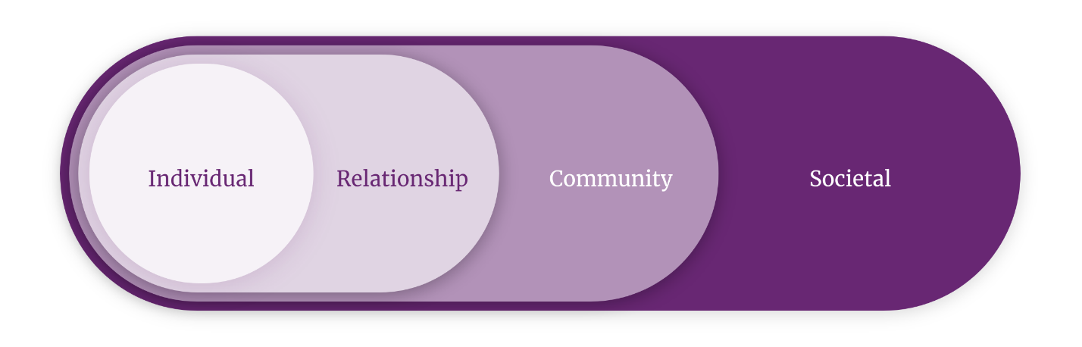
Socio-Ecological Model (SEM)
Dahlberg & Krug (2002)
Notes:
The social-ecological model conceptualizes health broadly and focuses on multiple factors that might affect health. The social ecological model understands health to be affected by the interaction between the individual, the group/community, and the physical, social, and political environments. Health professionals, researchers, and community leaders can use this model to identify factors at different levels that contribute to poor health and to develop approaches to disease prevention and health promotion that include action at those levels.

Slide 4
Socio-Ecological Model (SEM)
Decreasing excessive drinking in the post-secondary population
Individual: screening at health services or counselling, self-awareness, recovery
Relationship: parent engagement, freshman class, athletes, peers
Community: Prevention policies, communication awareness, consistent enforcement, faculty engagement, special events, promotion of healthy norms, system measurement
Societal: alcohol availability, alumni norms, party regulation, off-campus living contracts, keg registration, social host training, joint jurisdiction with local police, community partnership

Slide 5
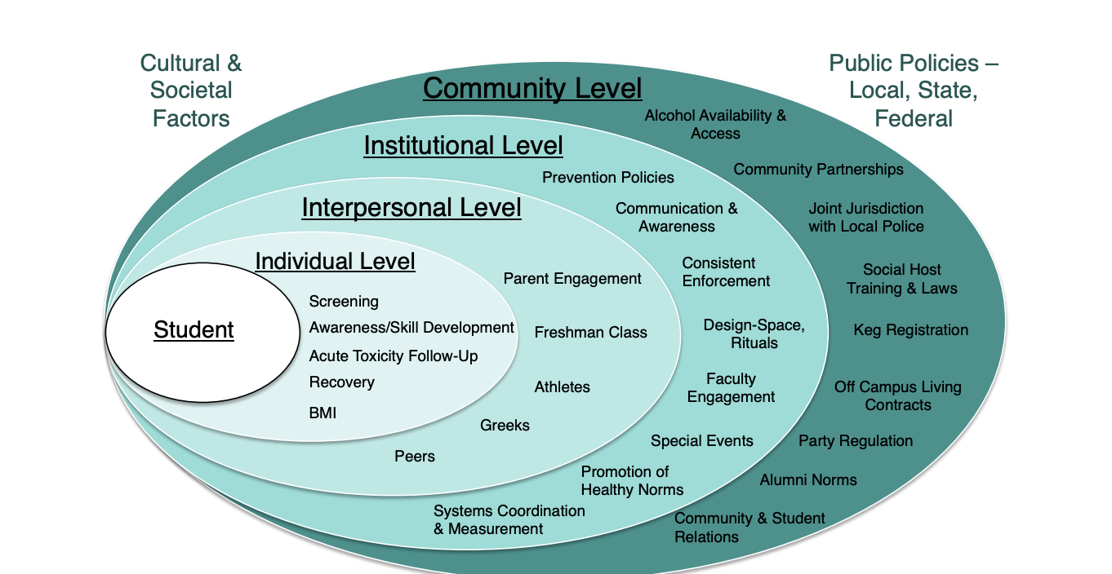
Johnson (2014)

Slide 6
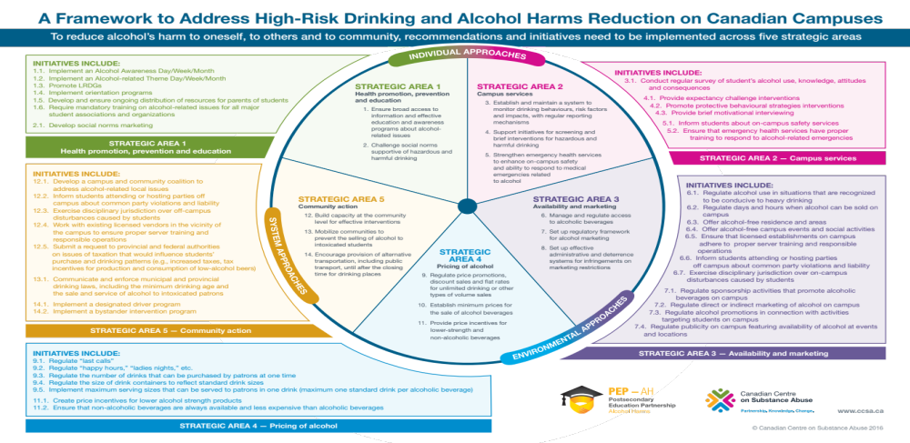
Canadian Centre on Substance Use and Addictions (CCSA) (2022)

Slide 7
Strengths
Systems Approach to Change (Johnson, 2014)
They were able to observe that the existing systems that were in place were perpetuating the very problems they were trying to improve (like policies that were not enforced, traditions that were allowed to continue despite the harms involved, etc.).
The community became more involved, educated and supportive regarding high-risk drinking concerns
Frequent monitoring and collection of data allow for how a collaborative team approaches the work.
Screening initiatives increase with the implementation of these frameworks

Slide 8
Limitations
Change Readiness and Resistance(Johnson, 2014)
The degree of readiness for change varies across colleges and universities
All participating institutions need to maintain leadership, systems to collaborate and share data, student engagement and consistent messaging and enforcement
There is resistance from some post-secondary institutions to participate effectively

Slide 9
References
Agency for Toxic Substances and Disease Registry [ATSDR] (2015, June 25). Principles of
community engagement - second edition: Models and frameworks for the practice of community engagement. https://www.atsdr.cdc.gov/communityengagement/pce_models.html
Canadian Centre on Substance Use and Addictions (CCSA) (2022). PEP-AH Framework: A
framework to address high-risk drinking and alcohol harms reduction on Canadian campuses. https://pepah.ca/framework/
Dahlberg, L.L., Krug, E.G., (2002). Violence: a global public health problem. In: Krug, E.,
Dahlberg, L.L., Mercy, J.A., Zwi, A.B., Lozano, R. World Report on Violence and Health. Geneva, Switzerland: World Health Organization, 1-21. https://www.cdc.gov/violenceprevention/about/social-ecologicalmodel.html
Johnson, L.C. (2014). Using a Public Health and Quality Improvement Approach to Address High-
Risk Drinking with 32 Colleges and Universities: White Paper. National College Health Improvement Plan. http://safesupportivelearning.ed.gov/sites/default/files/NCHIP%20WhitePaper%205%208%2014FINAL.pdf
Okanagan Charter (2015, June). An International Charter for Health Promoting University and
Colleges. International Health Promoting Universities & Colleges. https://www.healthpromotingcampuses.org/okanagan-charter

